Slide 1


ELG5901-EG00
Beta Release
Network optimization and analysis using AI
Group: AI_AWS3_MAY2022
Amir Safwat Halim Youssef
Abdelrhman Gaber Youssef Saad Rezkallah
Basma Reda Shaban Abd-Elsalam Abd-Elwahab
Ali Amin El-Sayed Mahmoud El-Sherif
Abdulrahman Muhammad AbdulSalam Ahmed
ID: 300327305
ID: 300327290
ID: 300327209
ID: 300327246
ID: 300327218

Slide 2
Table of contents
Beta Release-Basma Abd-Elwahab – 300327209
Problem Definition
Potential Benefits
Project Guidance
Project walkthrough
Critical requirements and solutions (1)
Critical requirements and solutions (2)
Critical requirements and solutions (3)
Critical requirements and solutions (4)
Critical requirements and solutions (5)
Future work

Slide 3
Problem Definition
Beta Release-Basma Abd-Elwahab – 300327209
Network failure detection and classification (the failure and its type) to provide lower maintenance cost and minimalize maintenance work.
5G network optimization using beamforming selection from lidar to increase data rate.

Slide 4
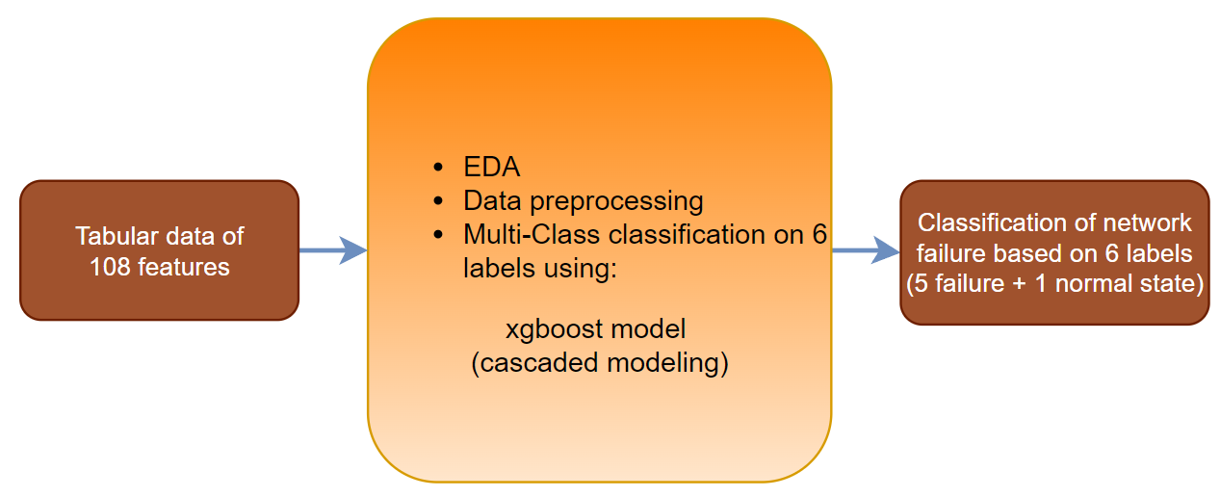
Problem Definition 1 (Failure detection and classification)
Beta Release-Basma Abd-Elwahab – 300327209
Possible Outputs:
Normal
bridge-delif
memory-stress-start
interface-loss-start
interface-down
vcpu-overload-start
Failure detection and classification input and output

Slide 5
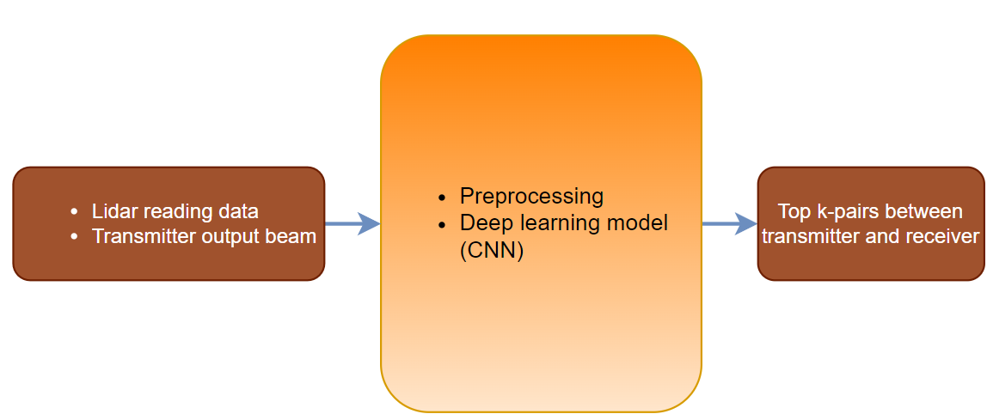
Problem Definition 2 (5G network optimization)
Beta Release-Basma Abd-Elwahab – 300327209
5G network optimization inputs and output

Slide 6
Potential Benefits to Sponsor/Users:
Beta Release-Basma Abd-Elwahab – 300327209
AWS Private 5G is currently available in the following AWS Regions: US East (Ohio), US East (N. Virginia), and US West (Oregon).
AWS has a service category in augmented reality (AR) and virtual reality (VR) fields that require 5G technology.
Optimization of beam selection efficiency will lead to the increase of spectrum efficiency which is beneficial to the company, nevertheless, users can experience convenience through AWS or any other network applied to it.

Slide 7
Project Guidance:
Beta Release-Basma Abd-Elwahab – 300327209
 | uOttawa Supporter (Dr. Murat Simsek) | Egypt Mentor (Dr. Anas Youssef) | Amazon Web Services (Sayed Eldawy)
Linkedin | https://www.linkedin.com/in/murat-simsek-32a7b220/ | https://www.linkedin.com/in/anas-youssef-62137370/ | https://www.linkedin.com/in/sayedeldawy

Slide 8
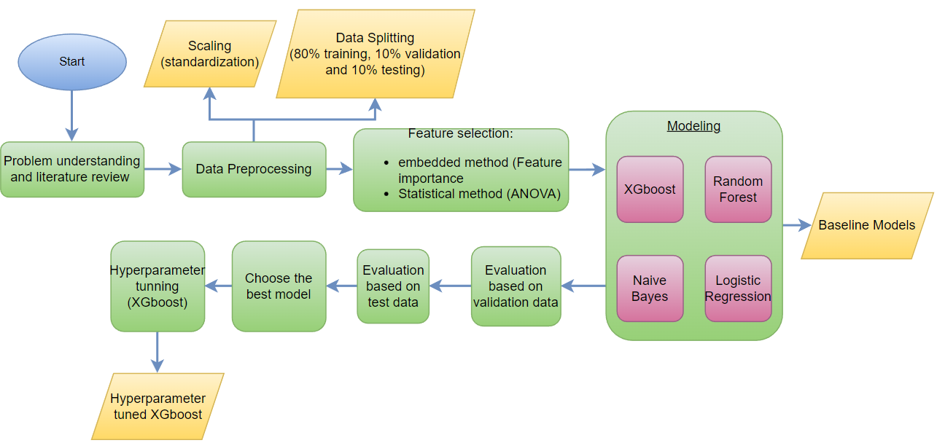
Project Walkthrough(part 1.0: Baseline model):
Beta Release-Basma Abd-Elwahab – 300327209
Baseline model
Flow chart of failure detection and classification (Multi-class classification)

Slide 9
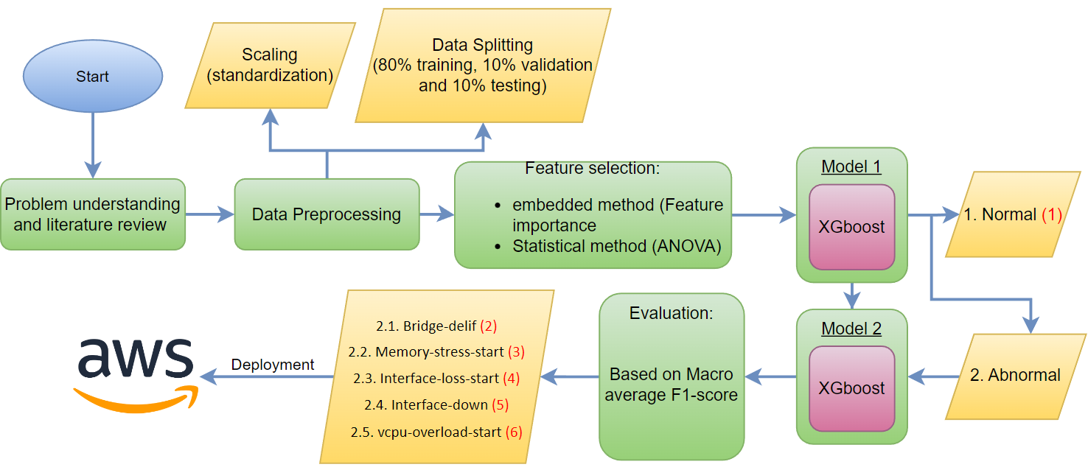
Project Walkthrough(part 1.1: cascaded modeling):
Beta Release-Basma Abd-Elwahab – 300327209
Flow chart of failure detection and classification (cascaded modeling)

Slide 10
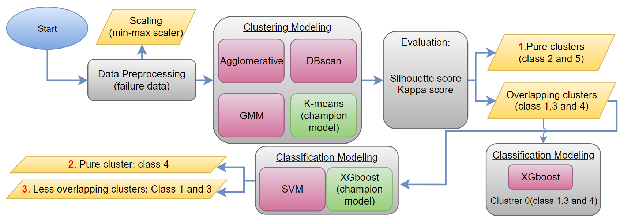
Project Walkthrough(part 1.2: clustering modeling):
Beta Release-Basma Abd-Elwahab – 300327209
Flow chart of failure detection and classification (Clustering Modeling)

Slide 11
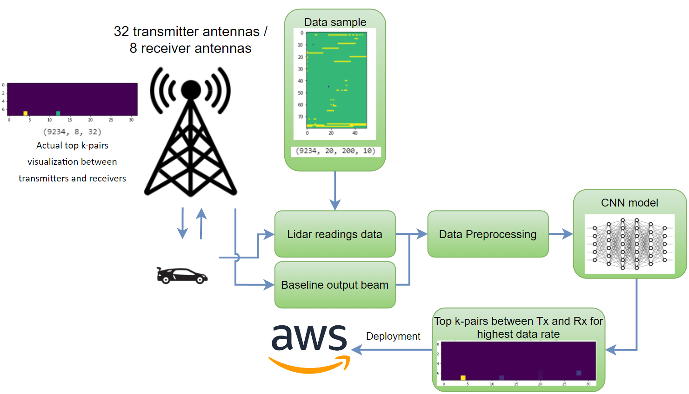
Project Walkthrough(part 2: beamforming selection):
Beta Release-Basma Abd-Elwahab – 300327209
Objectives:
Random search for alignment between transmitter and receiver to get highest possible data rate is unnecessary in many ways.
The following approach aims to reach the best alignment between transmission antennas to achieve higher data rate.
Flow chart of beam forming selection

Slide 12
Critical requirements 1:
Beta Release-Basma Abd-Elwahab – 300327209
Designing web application for cascaded model
Building and evaluating of cascaded model for tabular dataset
Beam forming selection preprocessing

Slide 13
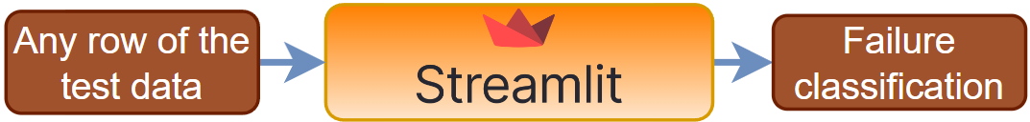
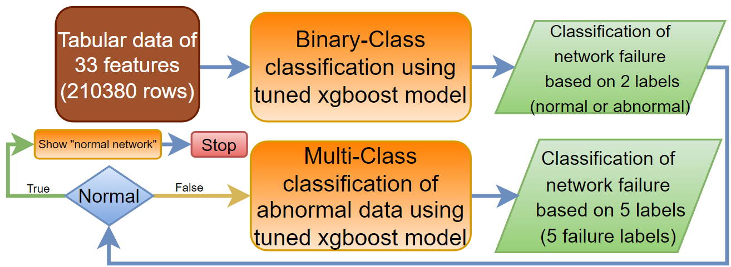
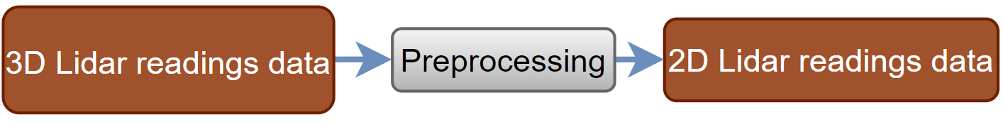
Solutions 1:
Beta Release-Basma Abd-Elwahab – 300327209
Creating and testing user interface using streamlit.
Building and evaluating cascaded model.
Beam forming selection preprocessing

Slide 14
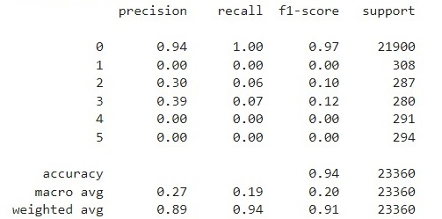
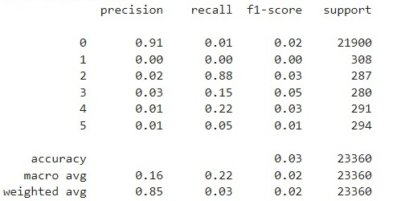
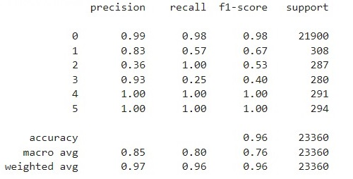
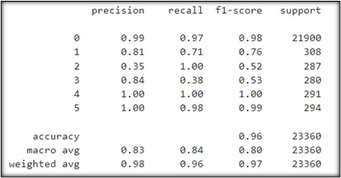
Baseline models:
Beta Release-Basma Abd-Elwahab – 300327209
Classification report (macro average F1-Score)
Logistic regression
naive bayes
Random Forest
xgboost

Slide 15
Solutions 1 (Cascaded model – binary classification model):
Beta Release-Basma Abd-Elwahab – 300327209
Binary XGboost tuning parameters:
Eta | Max_depth | Min_child_weight | subsample | colsample_bytree | Seed | eval_metric | scale_pos_weight
0.3 | 15 | 6 | 0.9 | 0.7 | 0 | Auc | 0.09

Slide 16
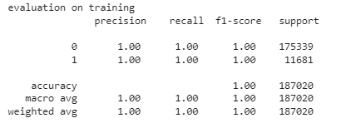
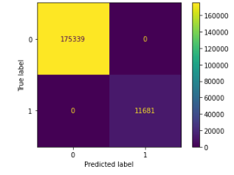
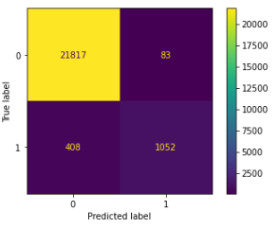
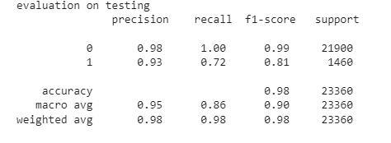
Solutions 1 (Cascaded model – binary classification model):
Beta Release-Basma Abd-Elwahab – 300327209
Binary XGboost confusion matrices:
Binary XGboost classification reports (F1-score):
Training confusion matrix
Testing confusion matrix

Slide 17
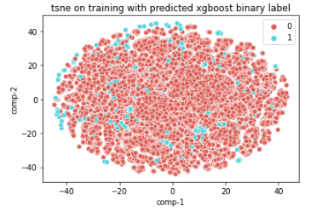
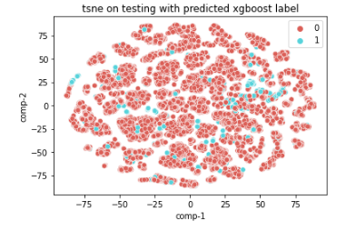
Solutions 1 (Cascaded model – binary classification model):
Beta Release-Basma Abd-Elwahab – 300327209
Binary XGboost TSNE plots:

Slide 18
Solutions 1 (Cascaded model – multi class classification on failure data):
Beta Release-Basma Abd-Elwahab – 300327209
Multi class XGboost parameters:
Eta | Max_depth | Min_child_weight | subsample | colsample_bytree | Seed | eval_metric
0.3 | 15 | 6 | 0.9 | 0.7 | 0 | mlogloss

Slide 19
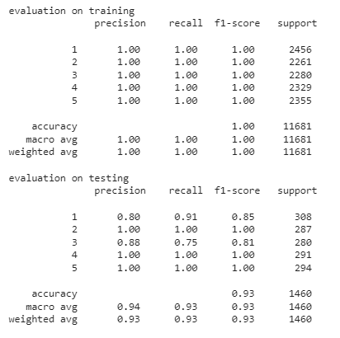
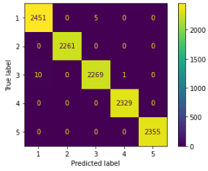
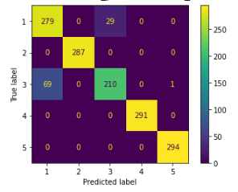
Solutions 1 (Cascaded model – multi class classification on failure data):
Beta Release-Basma Abd-Elwahab – 300327209
Multi class XGboost confusion matrices:
Multi class XGboost classification reports (F1-score):
Training CM
Testing CM

Slide 20
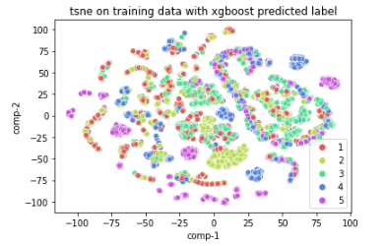
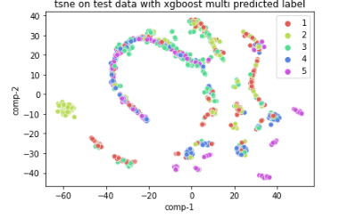
Solutions 1 (Cascaded model – multi class classification on failure data):
Beta Release-Basma Abd-Elwahab – 300327209
Multi class XGboost TSNE plots:

Slide 21
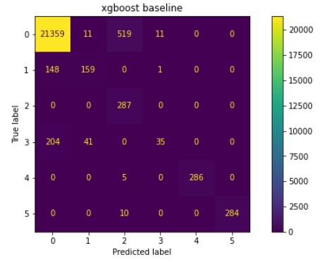
Solutions 1 (Comparison between cascaded modeling and baseline model):
Beta Release-Basma Abd-Elwahab – 300327209
Cascaded modeling confusion matrices on testing
Baseline model confusion matrix on testing
Model 1: binary classification (normal or abnormal)
Model 2: multi-class classification (5 abnormal states)
Multi-class classification
(1 normal state + 5 abnormal states)
Abnormal data

Slide 22
Critical requirements 2:
Beta Release-Abdulrahman Ahmed – 300327218
Building agglomerative model and evaluation for tabular dataset
Building DBSCAN model and evaluation for tabular dataset
Building model architecture for beam forming selection

Slide 23
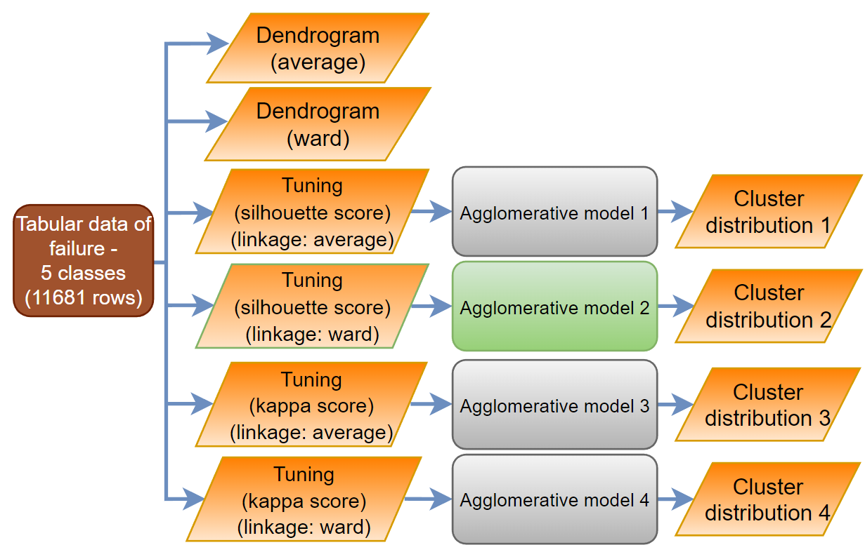
Solutions 2(agglomerative model):
Beta Release-Abdulrahman Ahmed – 300327218
Structure of agglomerative model for tabular dataset
Notes:
The problem was handled first as a binary class classification problem.
It was decided to make the problem more complex and realistic.

Slide 24
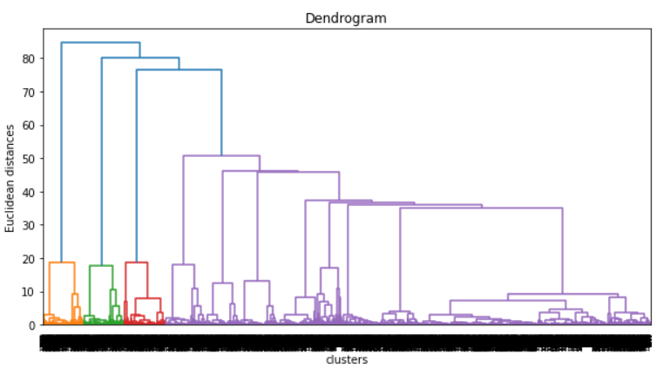
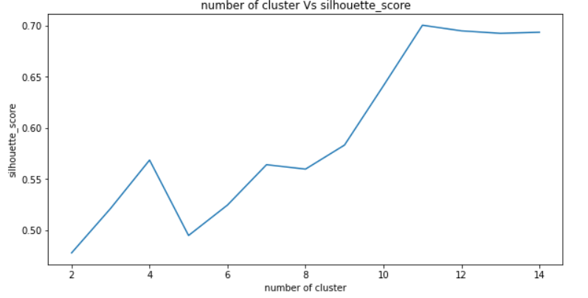
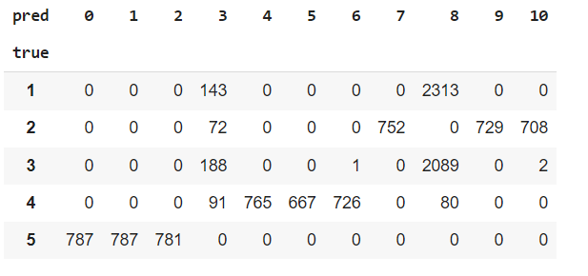
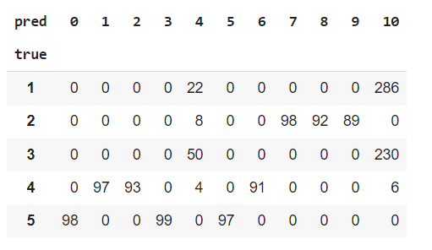
Solutions 2 (champion agglomerative model roots and results):
Beta Release-Abdulrahman Ahmed – 300327218
Dendrogram of (ward) agglomerative model
Number of cluster vs Silhouette score
K = 11
Cluster distribution for training dataset
Cluster distribution for testing dataset
Notes:
The problem was handled first as a binary class classification problem.
It was decided to make the problem more complex and realistic.

Slide 25
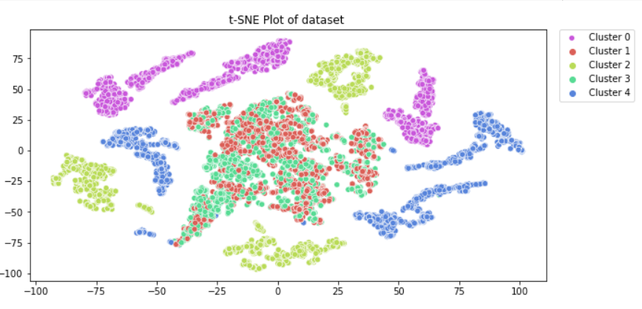
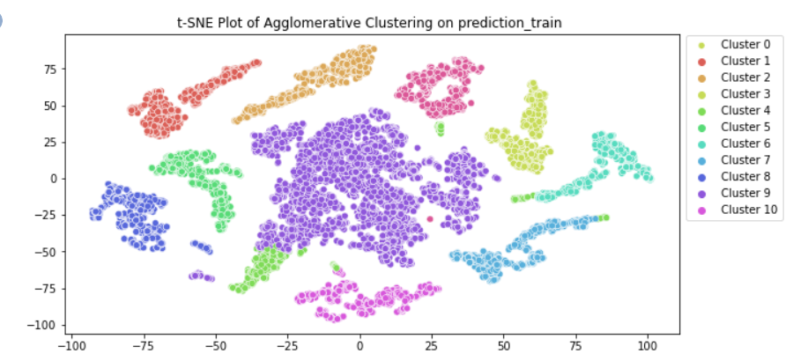
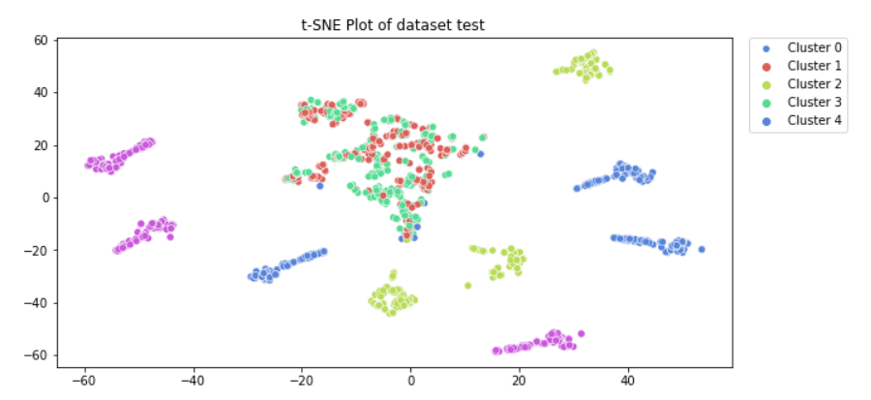
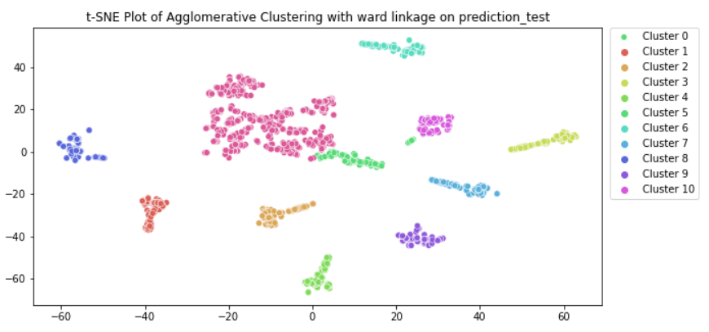
Solutions 2(champion agglomerative model results):
Beta Release-Abdulrahman Ahmed – 300327218
T-SNE plot for the training dataset (actual label)
T-SNE plot for prediction of training dataset
T-SNE plot for testing dataset
(actual label)
T-SNE plot for prediction of testing dataset
Notes:
The problem was handled first as a binary class classification problem.
It was decided to make the problem more complex and realistic.

Slide 26
Solutions 2(champion agglomerative model results):
Beta Release-Abdulrahman Ahmed – 300327218
Champion model evaluation metrics (at k = 11 and linkage: ward):
 | Evaluation metric | value
Training | kappa score | 0.02303368
 | Silhouette score | 0.7005552
Testing | kappa score | 0.00511996
 | Silhouette score | 0.63134602
Notes:
The problem was handled first as a binary class classification problem.
It was decided to make the problem more complex and realistic.

Slide 27
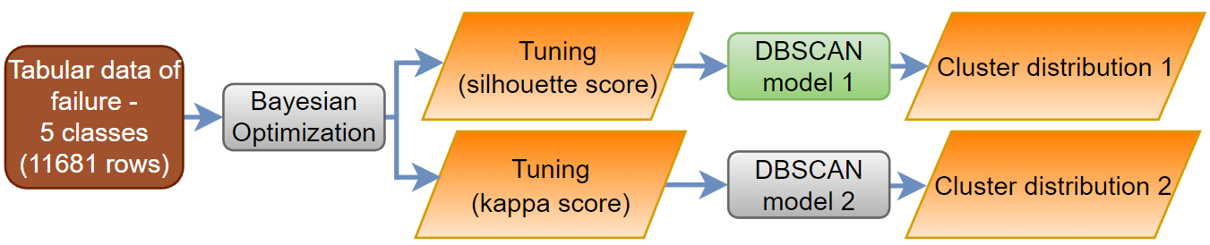
Solutions 2 (DBSCAN model):
Beta Release-Abdulrahman Ahmed – 300327218
Structure of DBSCAN model for tabular dataset
Notes:
The problem was handled first as a binary class classification problem.
It was decided to make the problem more complex and realistic.

Slide 28
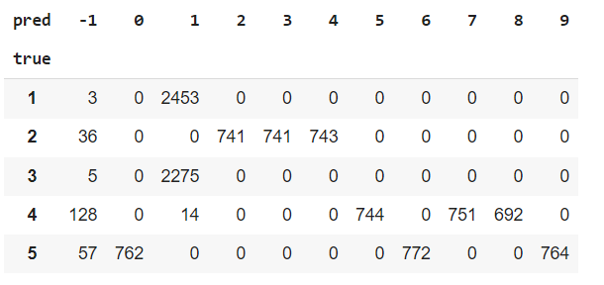
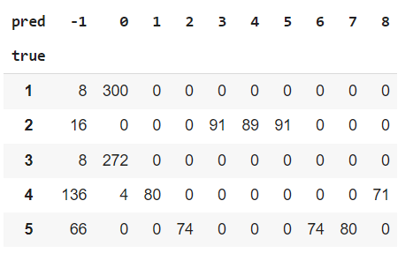
Solutions 2(champion DBSCAN model results):
Beta Release-Abdulrahman Ahmed – 300327218
Cluster distribution for training dataset
Cluster distribution for testing dataset
Notes:
The problem was handled first as a binary class classification problem.
It was decided to make the problem more complex and realistic.

Slide 29
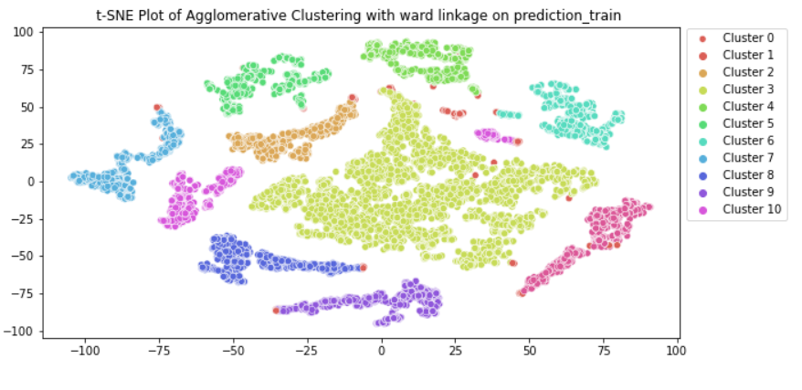
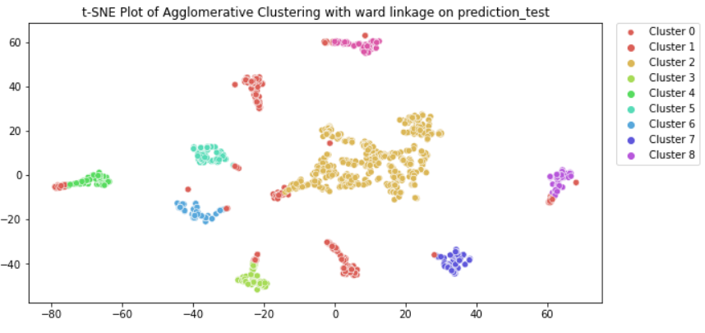
Solutions 2(champion DBSCAN model results):
Beta Release-Abdulrahman Ahmed – 300327218
T-SNE plot for the training dataset (actual label)
T-SNE plot for prediction of training dataset
T-SNE plot for testing dataset
(actual label)
T-SNE plot for prediction of testing dataset
Notes:
The problem was handled first as a binary class classification problem.
It was decided to make the problem more complex and realistic.

Slide 30
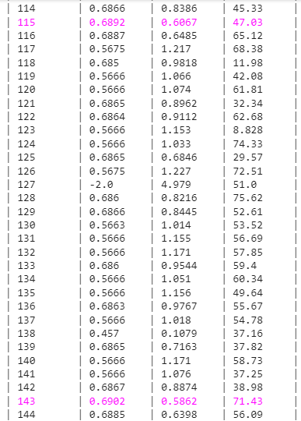
Solutions 2(champion DBSCAN model results):
Beta Release-Abdulrahman Ahmed – 300327218
Champion model evaluation metrics (at k = 11):
 | Evaluation metric | value
Training | kappa score | 0.159516
 | Silhouette score | 0.690042
Testing | kappa score | -0.061771
 | Silhouette score | 0.5762
Best DBSCAN parameters
Notes:
The problem was handled first as a binary class classification problem.
It was decided to make the problem more complex and realistic.

Slide 31
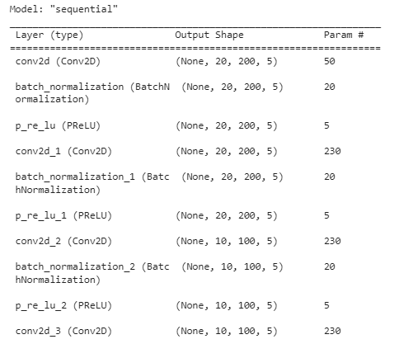
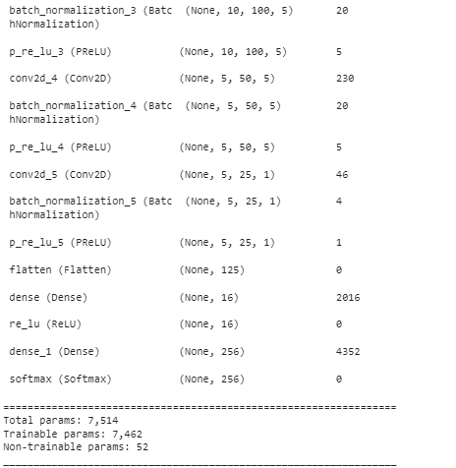
Solutions 2(model architecture for beam forming selection):
Beta Release-Abdulrahman Ahmed – 300327218
Notes:
The problem was handled first as a binary class classification problem.
It was decided to make the problem more complex and realistic.

Slide 32
Critical requirements 3 :
Beta Release-Amir Youssef – 300327205
Building GMM model and evaluation for tabular data
One vs all method for multi class classification (failure data)
Building K-means model and evaluation for tabular data

Slide 33
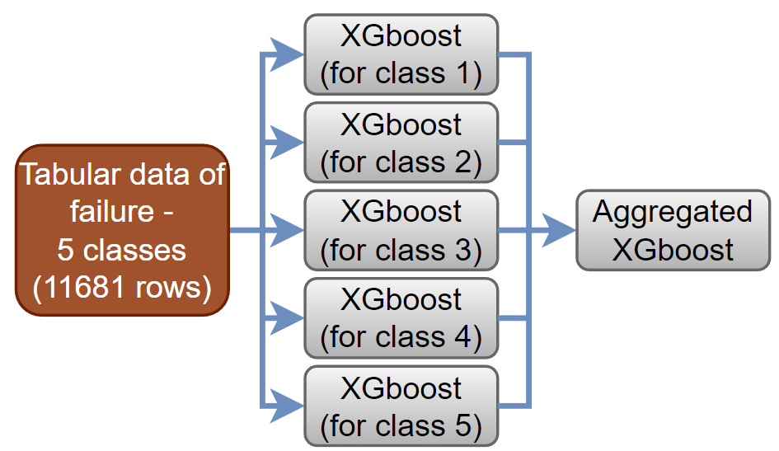
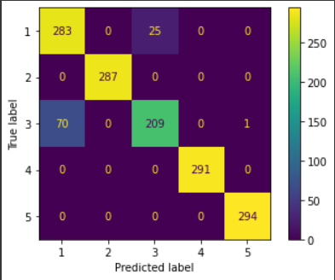
Solutions 3(One vs all method for multi class classification (failure data)):
Beta Release-Amir Youssef – 300327305
Confusion matrix of one vs all method on testing dataset
Structure of one vs all method for tabular dataset

Slide 34
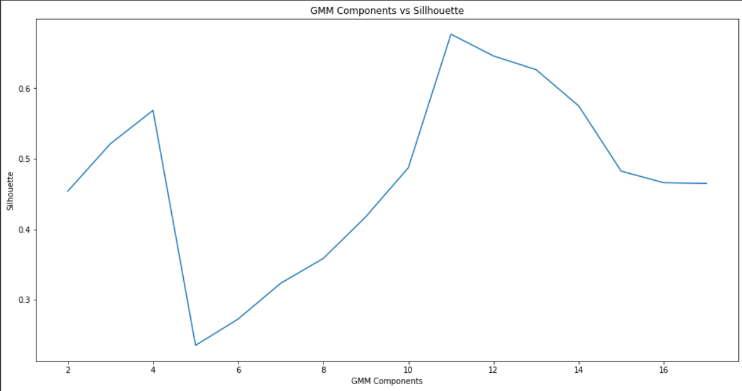
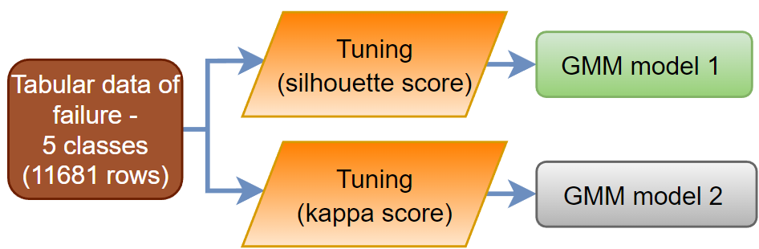
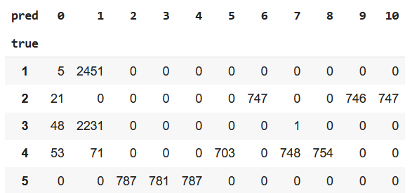
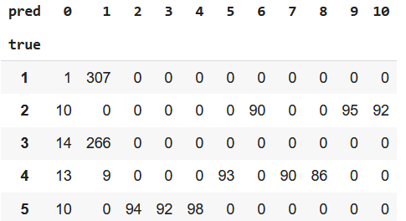
Solutions 3 (GMM model in clustering modeling and evaluation for tabular data):
Beta Release-Amir Youssef – 300327305
GMM model structure
Components vs silhouette score
components = 11
Cluster distribution for training dataset
Cluster distribution for testing dataset

Slide 35
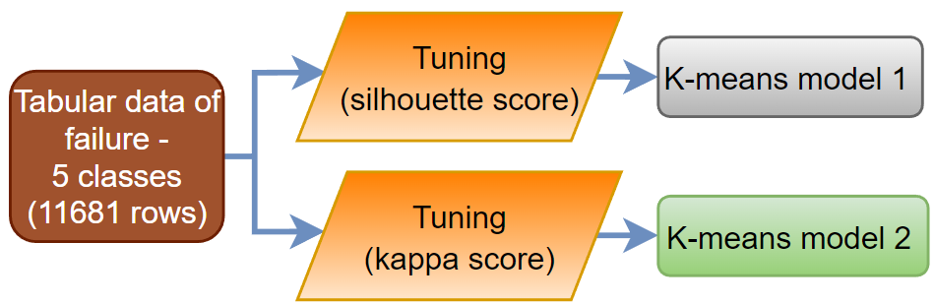
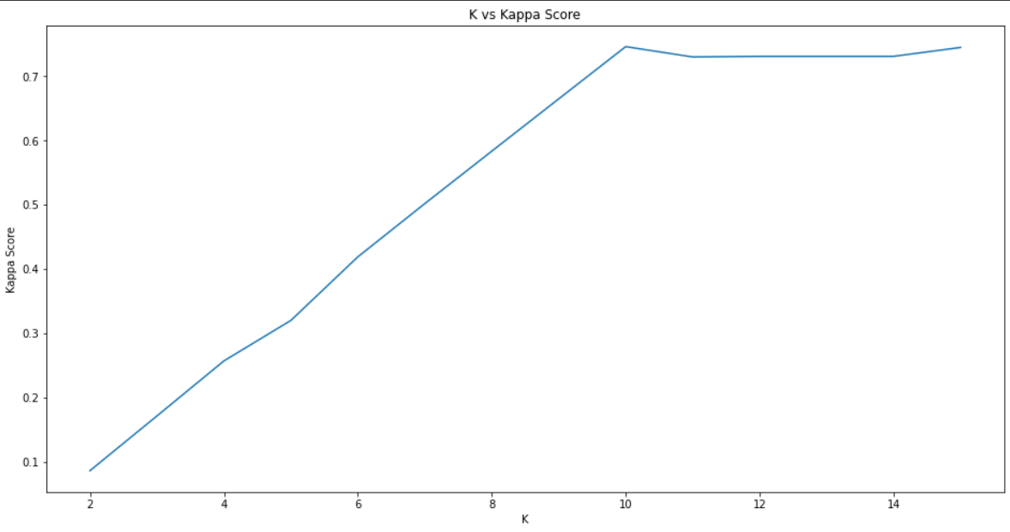


Solutions 3 (K-means model in clustering modeling and evaluation for tabular data):
Beta Release-Amir Youssef – 300327305
K-means model structure
Components vs kappa score
K = 10
Cluster distribution for training dataset
Cluster distribution for testing dataset

Slide 36



Solutions 3 (Results of cluster 0 in classification modeling using XGboost):
Beta Release-Amir Youssef – 300327305
Classification reports for cluster 0 using XGboost model
Confusion matrix of cluster 0 using XGboost model in training
Confusion matrix of cluster 0 using XGboost model in testing

Slide 37


Solutions 3 (K-means model for clustering modeling and evaluation for tabular data):
Beta Release-Amir Youssef – 300327305
T-SNE plot of K-means model for training dataset
T-SNE plot of K-means model for testing dataset

Slide 38


Solutions 3 (Clustering modeling with K-means model combined with classification modeling with XGboost model evaluation compared with cascaded modeling):
Beta Release-Amir Youssef – 300327305
Combined model classification report
(Clustering + classification modeling)
Combined confusion matrix
(Clustering + classification modeling)
Combined confusion matrix
(Cascaded modeling)

Slide 39
Critical requirements 4:
Beta Release-Abdelrhman Rezkallah – 300327290
Model training and evaluation for beam forming selection
Building federated learning model
Designing web application for beam forming model

Slide 40
Solutions 4 (Model training of beam forming selection):
Beta Release-Abdelrhman Rezkallah – 300327290
Shape of input Lidar data:
Training parameter | value
Optimizer | Adam(lr=1e-3, epsilon=1e-8)
Schedular | 0.690042
Callback | tf.keras.callbacks.LearningRateScheduler
Loss function | lambda y_true, y_pred: -tf.reduce_sum(tf.reduce_mean(y_true[y_pred>0] * tf.math.log(y_pred[y_pred>0]), axis=0))
Batch size | 16
Epochs | 25

Slide 41



Solutions 4 (Model evaluation of beam forming selection):
Beta Release-Abdelrhman Rezkallah – 300327290
Beamforming selection model top k-pairs accuracies
Beam forming selection model top k-pairs Learning rate
Beam forming selection model top k-pairs loss rate

Slide 42



Solutions 4 (Model results of beam forming selection):
Beta Release-Abdelrhman Rezkallah – 300327290
Receivers
Transmitters
Actual top k-pairs visualization between transmitters and receivers
Receivers
Lidar readings according to the reflected signal
Transmitters
Top k-pairs visualization between transmitters and receivers
after optimization

Slide 43

Solutions 4 (Federated learning architecture):
Beta Release-Abdelrhman Rezkallah – 300327290
Federated learning architecture

Slide 44
Solutions 4 (Model results of beam forming selection):
Beta Release-Abdelrhman Rezkallah – 300327290
Training parameter | value
Client optimizer | Adam(lr=5e-3)
Server optimizer | SGD(lr=.25)
Loss | CategoricalCrossentropy
Result after aggregation models on server side:

Slide 45

Solutions 4 (web application structure for beam forming model):
Beta Release-Abdelrhman Rezkallah – 300327290

Slide 46
Critical requirements 5:
Beta Release -Ali El-Sherif – 300327246
Deploying cascaded model on AWS
Deploying beam forming selection model on AWS
Model training and evaluation for beam forming selection

Slide 47

Solution 5.1(Deploying cascaded model on AWS):
Beta Release -Ali El-Sherif – 300327246
Deployment 1
Deployment 2
Architecture diagram of deploying cascaded model on AWS

Slide 48



Solution 5.1(screenshots):
Beta Release -Ali El-Sherif – 300327246
Screenshots of deploying cascaded model on AWS

Slide 49

Solution 5.2(Deploying beam forming selection model on AWS):
Beta Release -Ali El-Sherif – 300327246
Deployment 3
Deployment 4
Architecture diagram of deploying beam forming selection model on AWS

Slide 50



Solution 5.2(screenshots):
Beta Release -Ali El-Sherif – 300327246
Screenshots of deploying beam forming selection model on AWS

Slide 51
Deployment Considerations:
Beta Release -Ali El-Sherif – 300327246
 | Cascaded model | Beam forming selection model
Amazon EC2 instance | T2.micro | G5.xlarge
Amazon EC2 AMI | ubuntu-jammy-22.04-amd64-server-20221201 | Deep Learning AMI GPU TensorFlow 2.11.0 (Ubuntu 20.04) 20221220
Docker version | 20.10.22, build 3a2c30b | 20.10.22, build 3a2c30b
Used models | Xgboost(v0.90) | tensorflow.keras.Sequential Tensorflow(v2.9.0)
Dependencies (EC2s and docker images) | Numpy, pandas, streamlit, streamlit_option_menu, joblib, scikit-learn, matplotlib, pillow | Streamlit, streamlit_option_menu, pillow, joblib, matplotlib, tensorflow_hub, numpy, python-time, pandas, protobuf(v3.20.1)

Slide 52
Deployment Considerations:
Beta Release -Ali El-Sherif – 300327246
 | Cascaded model | Beam forming selection model
Amazon ECR |  | 
Amazon ECS |  | 
Capacity provider |  | 
AWS Fargate |  | 
Amazon CLI v2 | V2 | V2
PuTTY (EC2 access) |  | 

Slide 53
Deployment Cost (production scale using us-east-1 region):
Beta Release -Ali El-Sherif – 300327246
 |  | Cascaded model |  | Beam forming selection model
 |  | Deployment 1 | Deployment 2 | Deployment 3 | Deployment 4
EC2 (T2.micro) |  | 0.0116$/hour, 8.47$/month | 0.0116$/hour, 8.47$/month |  | 
EC2 (G5.Xlarge) |  |  |  | 1.006$/hour, 734.38$/month | 1.006$/hour, 734.38$/month
Elastic IP |  | 3.65$/month | 3.65$/month | 3.65$/month | 3.65$/month
Elastic block store (EBS) |  | 2.4$/month | 2.4$/month | 2.4$/month | 2.4$/month
Elastic container registry (ECR) |  | 69.82$/month | 69.82$/month | 144.75$/month | 144.75$/month
Total (per month) | 969.52$ |  | 84.34$ |  | 885.18$

Slide 54
Future work:
Beta Release -Ali El-Sherif – 300327246
Deploying federated learning on AWS.
Applying beam forming selection part through a real scenario with the cooperation of an industrial company.

Slide 55
Thank You

